Slide 1







Lecture 16:
Middleware Basics
Course - Web Development - III
-By
Pratik Raj Verma
welcome@krmangalam.edu.in
Sohna Road,Gurugram,Haryana 122103

Slide 2

| Table of Contents
Middleware
Built-in Middleware
Custom Middleware
Third Party Middleware
References.
The End.

Slide 3

|
You enter an airport. Can you directly board the airplane?
No
You first pass through Security Check, Ticket Verification, Luggage Check. Only then can you enter the plane.

Slide 4
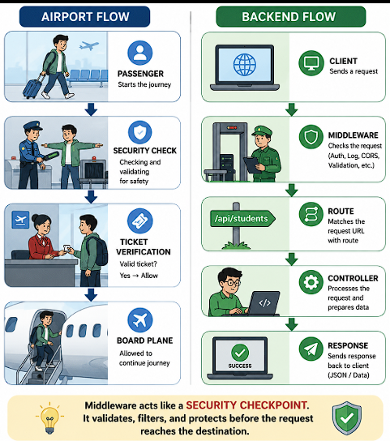
|
Question: Can a request directly access backend routes?
Not always
There is something in between. That is called: Middleware

Slide 5
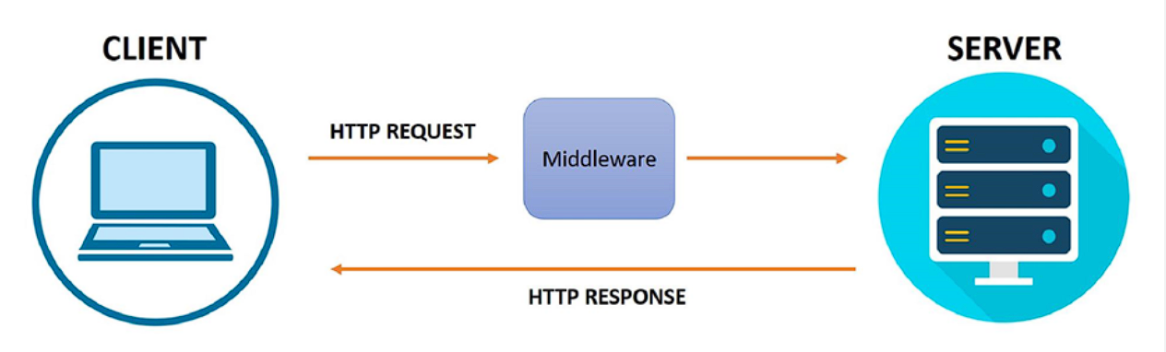
| Middleware
Middleware is a function that executes between receiving a request and sending a response.
Middleware can:
Modify Request
Modify Response
Validate Data
Authenticate Users
Log Information
Stop Requests

Slide 6
| Middleware
Types of Middleware
Express provides different types of middleware:
Built-in Middleware
Custom Middleware
Third-Party Middleware

Slide 7
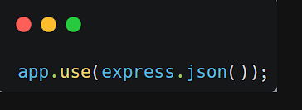
| Built-in Middleware
Built-in Middleware are middleware functions that are already provided by Express.js.
express.json()
One of the most commonly used built-in middleware is express.json(), which converts incoming JSON data into a JavaScript object so that it can be accessed through req.body.
Read JSON data
Convert JSON into JavaScript Object
Without it:
req.body returns: undefined

Slide 8
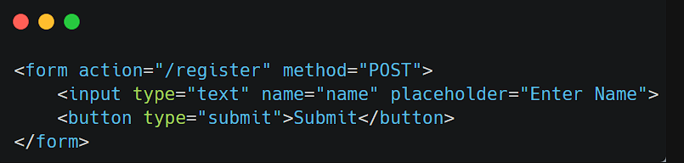
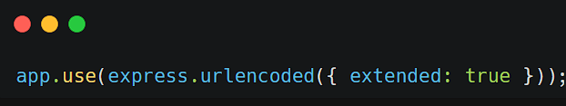
| Built-in Middleware
express.urlencoded()
express.urlencoded() is a built-in Express middleware that parses data sent from HTML forms and makes it available in the req.body object.
When a user submits a form, the data is sent in URL-encoded format. The express.urlencoded() middleware converts this data into a JavaScript object so that it can be easily accessed inside the route handler.

Slide 9
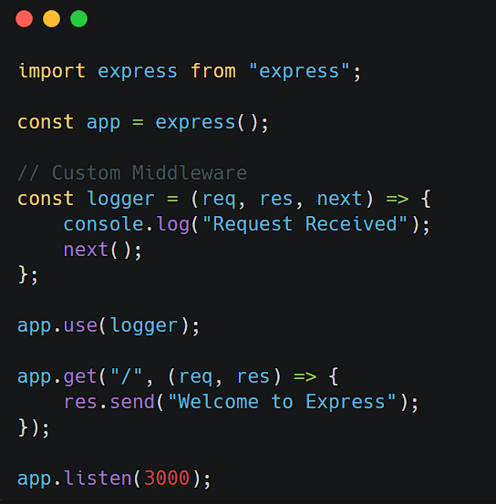
| Custom Middleware Middleware
Custom Middleware is a middleware function created by the developer to perform specific tasks before a request reaches the route handler.
It can be used for logging, authentication, validation, request tracking, and many other custom operations.
How it works
Client sends a request.
logger middleware executes first.
"Request Received" is printed in the console.
next() passes control to the next middleware or route.
The route handler sends the response.

Slide 10
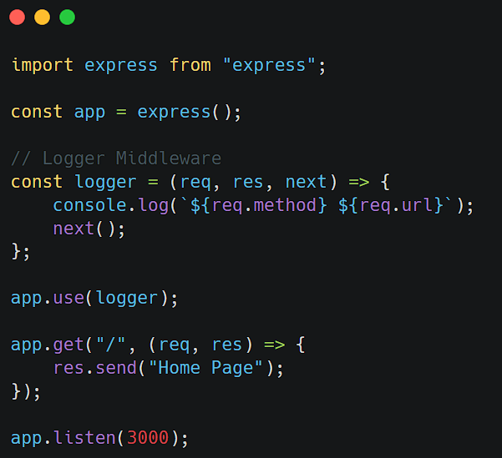
| Custom Middleware Middleware
Logger Middleware
It is a middleware function that records information about incoming requests, such as the request method, URL, time, or user activity.
It is commonly used for monitoring, debugging, and tracking application usage.
Output
If a user visits:
http://localhost:3000/
Console:
GET /

Slide 11
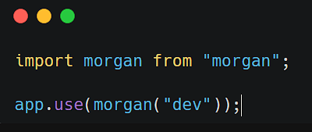
| Third Party Middleware
Third-Party Middleware refers to middleware functions developed by external developers or organizations and installed through npm.
These middleware packages provide additional functionality that is not included in Express by default.
Common examples include CORS, Morgan, Helmet, Cookie-Parser
1. Morgan Middleware
npm install morgan
Morgan is a third-party middleware used for logging HTTP requests. It helps developers monitor incoming requests and debug applications.
GET /students 200 10 ms

Slide 12
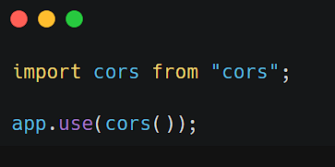
| Third Party Middleware
2. CORS Middleware
CORS (Cross-Origin Resource Sharing) is used to allow requests from different domains, ports, or origins.
npm install cors
Use Case:
React frontend (localhost:5173)
calling Node backend (localhost:3000).

Slide 13
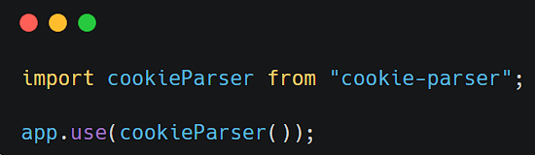
| Third Party Middleware
3. Cookie-Parser Middleware
Cookie-Parser parses cookies attached to client requests and makes them available in req.cookies.
npm install cookie-parser
Access Cookie:
console.log(req.cookies);

Slide 14
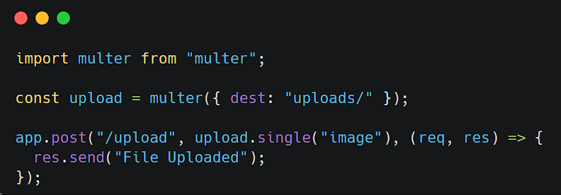
| Third Party Middleware
4. Multer Middleware
Multer is used to handle file uploads such as images, PDFs, and documents.
npm install multer

Slide 15
| Third Party Middleware
Middleware | Purpose
Morgan | Request Logging
CORS | Cross-Origin Requests
Helmet | Security Headers
Cookie-Parser | Read Cookies
Express-Session | Session Management
Multer | File Upload
Compression | Response Compression
Express-Rate-Limit | API Rate Limiting
JWT Middleware | Token Authentication
Passport | Authentication & OAuth

Slide 16

| Check Your Understanding
Question : Which function allows request to move to the next middleware?
Options : A. send()
B. listen()
C. next()
D. json()
Answer : C. next()
Explanation:
next() passes control to the next middleware or route handler in the request-response cycle.

Slide 17
| Check Your Understanding
Question : Which middleware is used to read JSON data?
Options : A. cors()
B. express.json()
C. logger()
D. next()
Answer : B. express.json()
Explanation:
express.json() parses incoming JSON data and makes it available in req.body.

Slide 18
| Check Your Understanding
Question : Which middleware allows frontend and backend communication across
different origins?
Options : A. express.json()
B. auth()
C. logger()
D. cors()
Answer : D. cors()
Explanation:
cors() allows requests between different origins, such as a React frontend and Express backend running on different ports.

Slide 19
| References
MDN Web Docs : Comprehensive and official documentation for Express Js 🔗https://developer.mozilla.org/en-US/docs/Learn_web_development/Extensions/Server-side/Express_Nodejs
W3Schools : Beginner-friendly express tutorials with examples and interactive editors. 🔗https://www.w3schools.com/nodejs/nodejs_express.asp
Express Official- A comprehensive tutorial-style website that covers core Express JS concepts in depth.
🔗https://expressjs.com/en/

Slide 20
Thanks
For
Watching
Course - Web Development - III
welcome@krmangalam.edu.in
Sohna Road,Gurugram,Haryana 122103

